Slide 1

Department of Operations
Facilities Construction
Food Services Transportation
Security

Slide 2
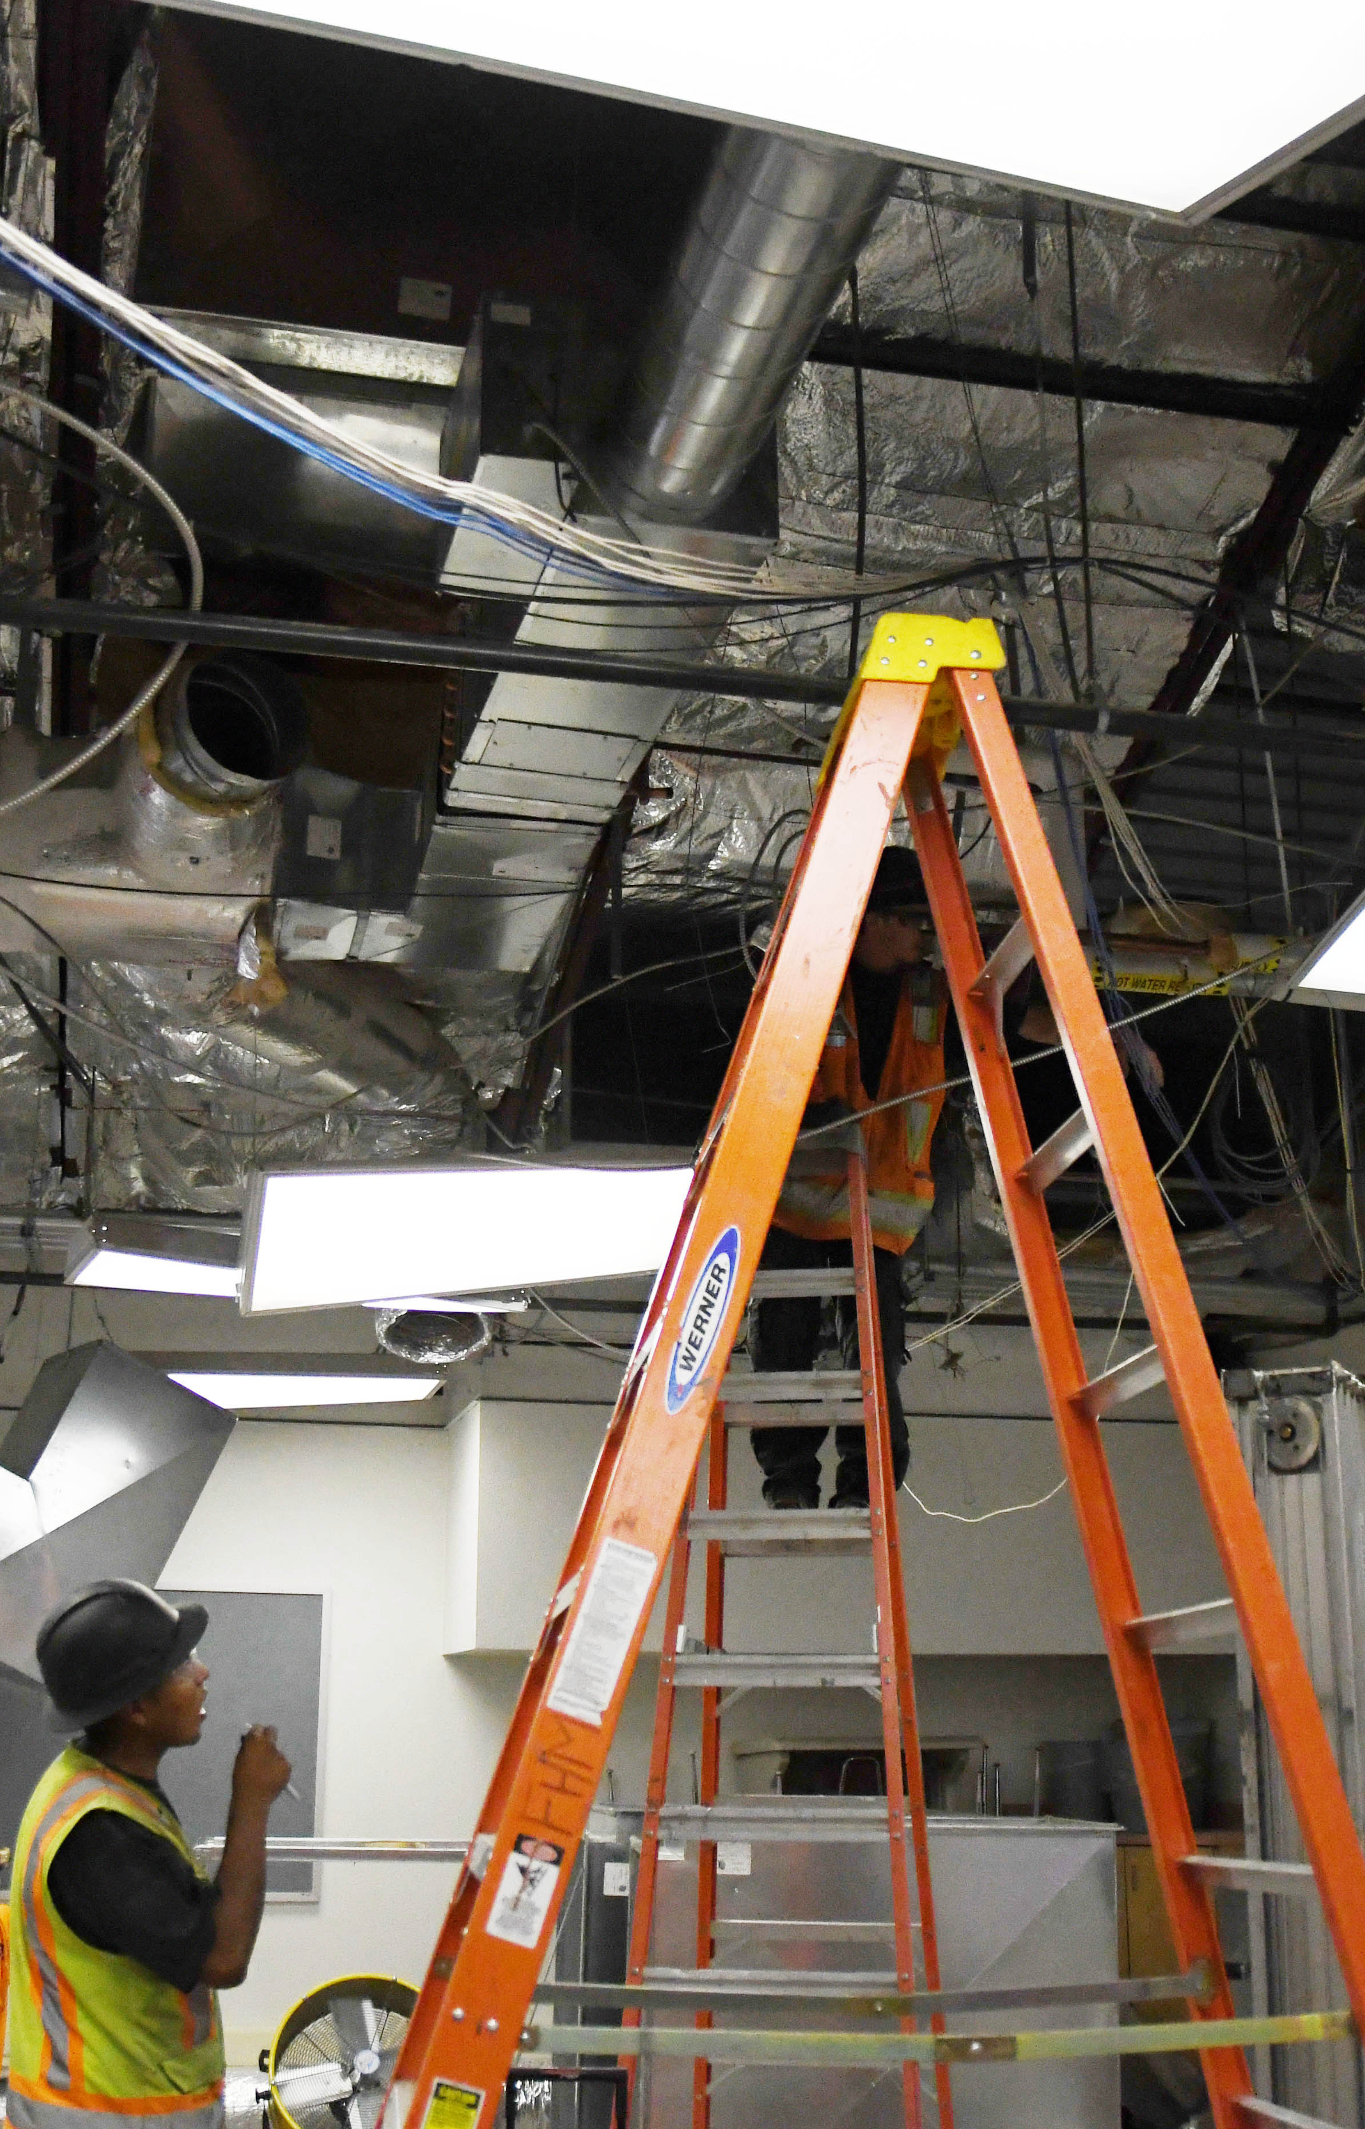
Facility Budget
Custodial Budget - $190,000.00 (FY20-21) This budget supports 17 schools and 8 support buildings totaling 1,692,931 sqft
  Replacement of Custodial equipment
  Cleaning supplies
  Equipment repairs
  Staff training
  Department Needs for SY21-22
  One (1) FTE for Bond Wilson
  Batteries for touchless dispensers
Grounds Budget - $315,000.00 (FY20-21) this budget supports 495 acres of playgrounds and athletic fields
  Updating equipment
  Equipment maintenance
  Weed control
  Fertilizing program
  Irrigation maintenance and repair
  Department Needs for SY21-22
  Replacement of heavy equipment
  Shiprock Pump house construction
  JNE pump house upgrade
  JN Baseball fields renovation

Slide 3
Facility Budget
Maintenance Budget - $930,481.00 (SY20-21) this budget supports the daily functions of the 17 schools, 8 support buildings and 112 teacher housing units.
General maintenance supplies
Staff training
Equipment repair
General repair/maint of buildings
Department Needs for FY21-22
  3 FTE Maintenance positions ( Gen Maint, Grounds Foreman KC and Housing)
  1 FTE Finance/Housing Secretary
  Increase wage rates for the Skilled and Licensed HVAC and Electrical Positions
  Replacement of six (6) vehicles with over 125k miles and more then 20yrs old
  Bobcat, Skidsteer, Cement mixer, Trailer, Skylift, Forklift, Lg Air Compressor, Dually utility bed, Sewer Machine
  District Wide Asphalt repairs
  District wide Playground shade structures
  Budget increase for Merv 13 filters

Slide 4
Construction Budget
Construction Budget - $15,079,726.00 (SY20-21) this budget supports the 17 schools 8 support buildings and 112 housing units. Total funded PSCOC projects 13 million. Annual Budget 3.7 million.
Eva B HVAC – Funded by the PSCOC (Public School Capital Outlay Committee)
Security Upgrades Ph 1 & 2 - Funded by the PSCOC
Mesa Heights and CO housing projects – Funded by the PSCOC
NES FMP – Funded by the PSCOC
Department Needs for FY21-22
  New 5 yr Master Plan
  Warehouse Fire suppression system & Freezer/Cooler
  SHS artificial turf replacement
  KCHS Fieldhouse HVAC & Re-roof renovation
  SHS replacement of Boilers
  SHS common floor replacement
  Newcomb HS Skyhawk Gym Sidewalk Replacement Ph 2
  CO Electronic Billboard
  Naschitti Sewer Main upgrade

Slide 5

Food Service Budget
Budget $6,061,929.00 (FY20-21) Funds used to support the Food Service program come from USDA school breakfast program and the school lunch program.
Department Needs for FY21-22
  New Freezer/Cooler at the Kirtland Warehouse
  Replacement of school kitchens Freezer/Cooler condensers
  Replacement of Kitchen equipment

Slide 6



Security
$485,000.00 (FY20-21) This budget supports the SRO MOU currently in place and PPE supplies
Department Needs for FY21-22
Increase in FTE salary for security guard
Radios
Continued PPE support

Slide 7
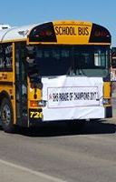
Transportation
$1,942,282.00 (FY20-21) Transportation is funded by NM State Transportation Department based on student ridership.
Bus maintenance and repairs
Fuel
General supplies
Salaries/benefits
Department Needs for FY 21-22
  Our biggest expense is bus drivers salary (for the past 3 years, our ridership has decrease, therefore, a decrease in funding).
  Updated shop equipment
  Updated restrooms
  Small building for Tire Storage in Shiprock
  New facility in Newcomb
  Increase in fuel cost
  Increase in providing meals to students in remote as well as providing WIFI services

